Slide 1

Bose Einstein Condensate (BEC)
Otávio Perez Palamoni - ID: 14180168
Fundamentals of the Interaction of Radiation with Matter (2023.1) - SFI5905

Slide 2
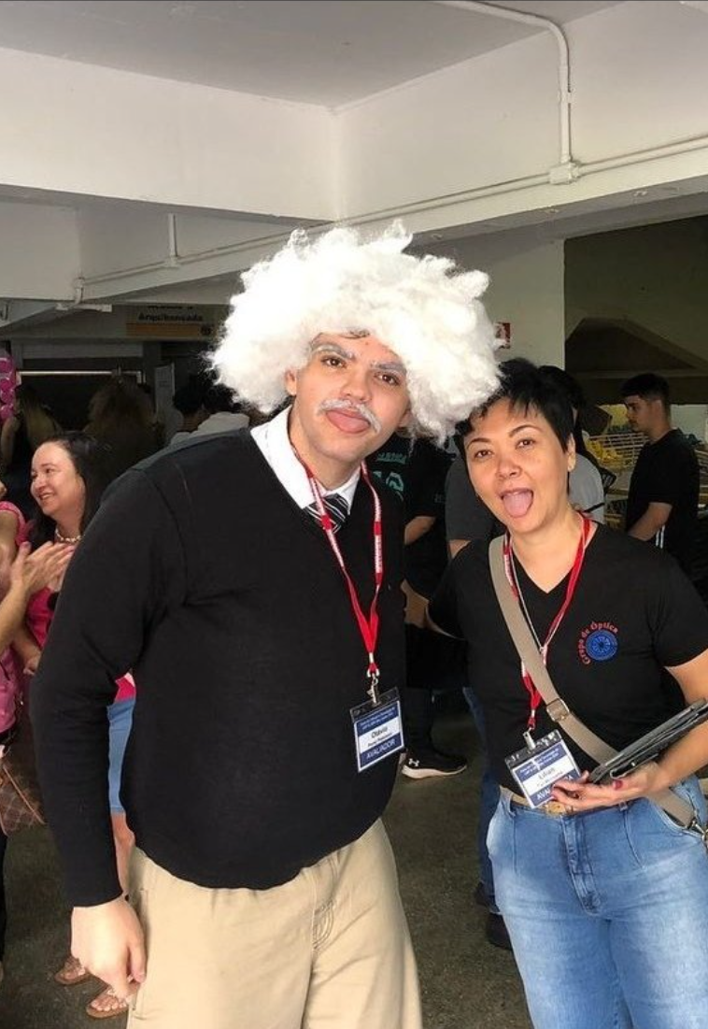
Who am I
1999: Born in Franca-SP
2017-2022: Graduated from the Federal University of São Carlos (UFSCar)
2018-Present: Works for Bright photomedicine
2022-Present: “Postgraduating” (Master) on IFSC

Slide 3
Topics
Fermions and Bosons
Introduction on Bose-Einstein-Condensate (BEC)
  Example - Ideal Bose gas
  Real Bose gas - Gross-Pitaevskii equation (GPE)
Experiments involving BECs
  “Observation of Bose-Einstein condensation in a dilute atomic vapor, 1995”
  3D reconstruction on BECs
Conclusion
Codes
References

Slide 4
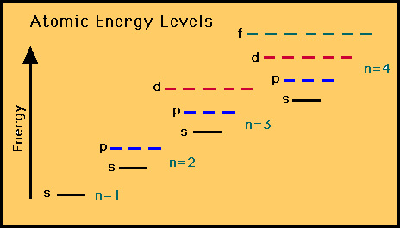
Fermion vs Bosons
Pauli Exclusion Principle: “In a single atom, no two electrons will have an identical set or the same quantum numbers (n, l, ml, and ms)”
Fermions: obey the Pauli exclusion principle, have half-integer spin values (1/2, 3/2, ...).
  Examples of fermions: Electrons, Protons, and Neutrons.
Bosons: do not obey the Pauli exclusion principle, have half-integer spin values (1,2,3,...).
  Examples of bosons: Photons, Gluons, and the W and Z bosons

Slide 5
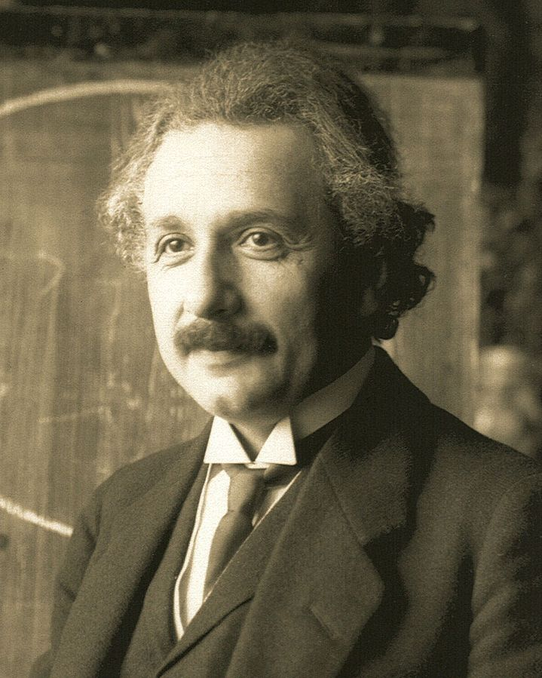
Bose-Einstein Condensate (BEC)
Initially conceptualized by Albert Einstein in 1925, building upon the earlier work of Satyendra Nath Bose.
Cooling a high-density gas of bosons, below the critical temperature (TC) resulting in a condensation of particles occupying the lowest energy state.

Slide 6
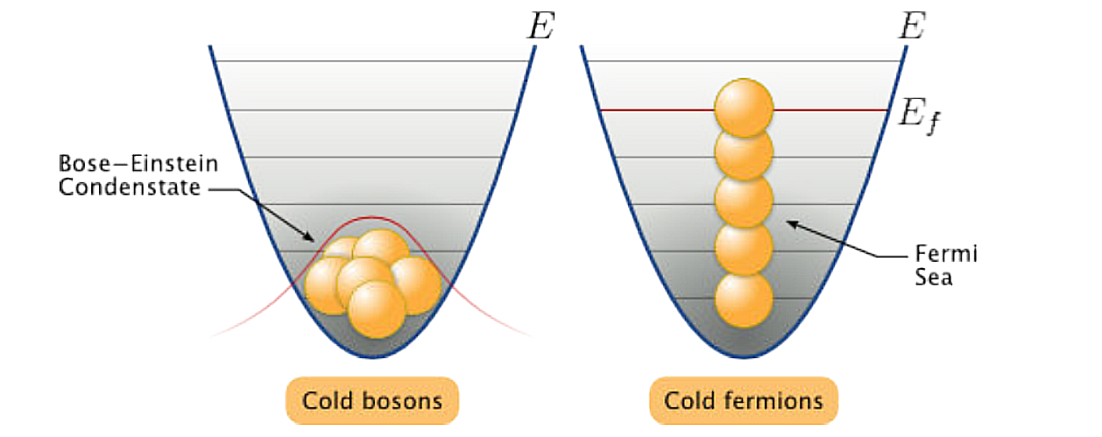
Bose-Einstein Condensate (BEC)

Slide 7


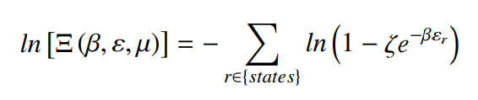

Ideal Bose trapped by an 3D harmonic potential
Suppose an ideal gas (non-self-interacting particles), the distribution of those particles can be calculated using the partition function (𝚵)
Manipulating it we find a new expression for 𝚵:

Slide 8
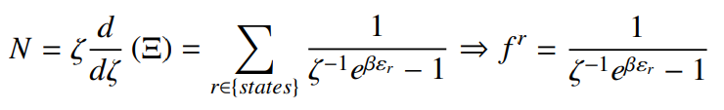
Ideal Bose trapped by an 3D harmonic potential
Where ζ is the system fugacity (chance of the particule escape from the system), The total number of particles (N) can be calculate in function of the fugacity.

Slide 9
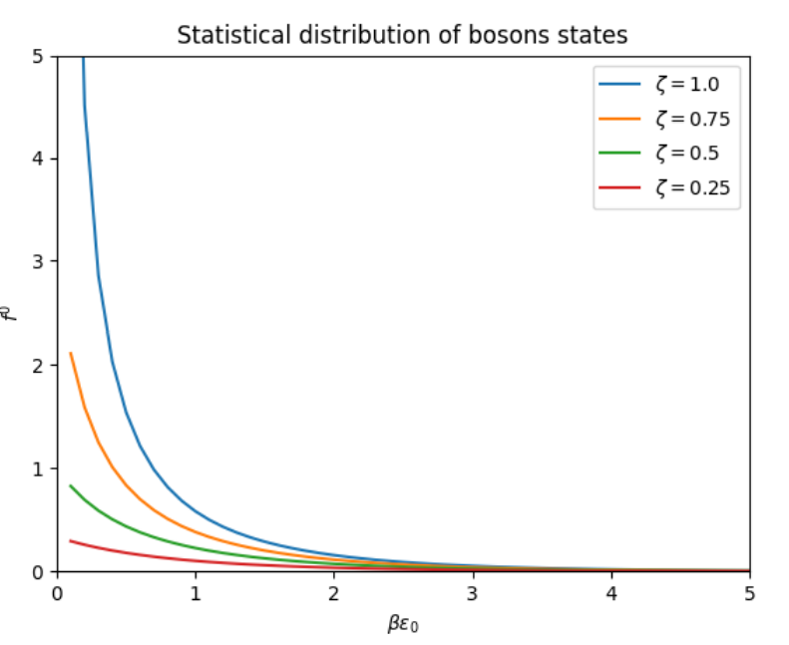

Ideal Bose trapped by an 3D harmonic potential
As the system is approxing the ground state (r=0), all particles tend to the same level:

Slide 10
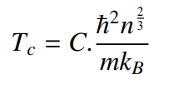
Ideal Bose trapped by an 3D harmonic potential
Critical Temperature (Tc): Denotes when the transition of phase occurs, for a uniform gas trapped this temperature is defined as:
Where C is a constant that depends on the trap, n is the density of particles, m is the mass of the particule, kB is the Boltz constant and ħ is the reduced Planck constant.

Slide 11
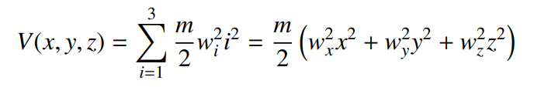

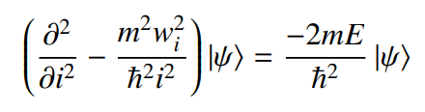
Ideal Bose trapped by an 3D harmonic potential
3D harmonic potential:
Using the Schrodinger equation we find that for each axis:

Slide 12



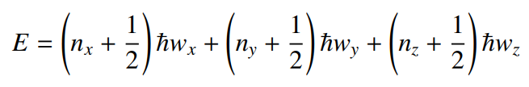
Ideal Bose trapped by an 3D harmonic potential
Assuming α and β as:
Schrodinger’s equations becomes the following DE:
Which is the Hermite Differential Equation, thus the eigenvalues of E are:

Slide 13
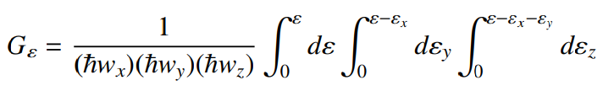

Ideal Bose trapped by an 3D harmonic potential
Defining an G(ε) function as:
The degeneracy ρ is calculated as:

Slide 14
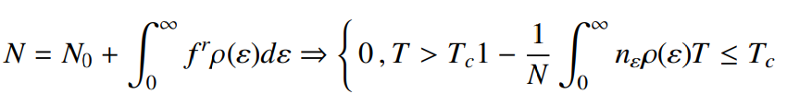
Ideal Bose trapped by an 3D harmonic potential
By defining this phase transition as when the excited states are saturated, forcing any new particle go to the ground state. In this situation, the chemical potential is minimum (µ = 0), so:
N0/N is the condensed fraction and it shows the system particules fractions that are in ground state and nε is the occupancy of states with energy ε.

Slide 15
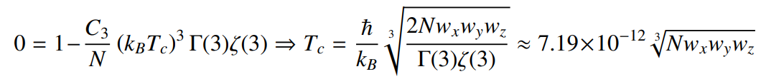
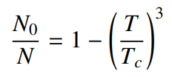
Ideal Bose trapped by an 3D harmonic potential
When T = Tc, then No = 0, thus an expression for Tc can be established
Than the condensate fraction expression becomes:

Slide 16

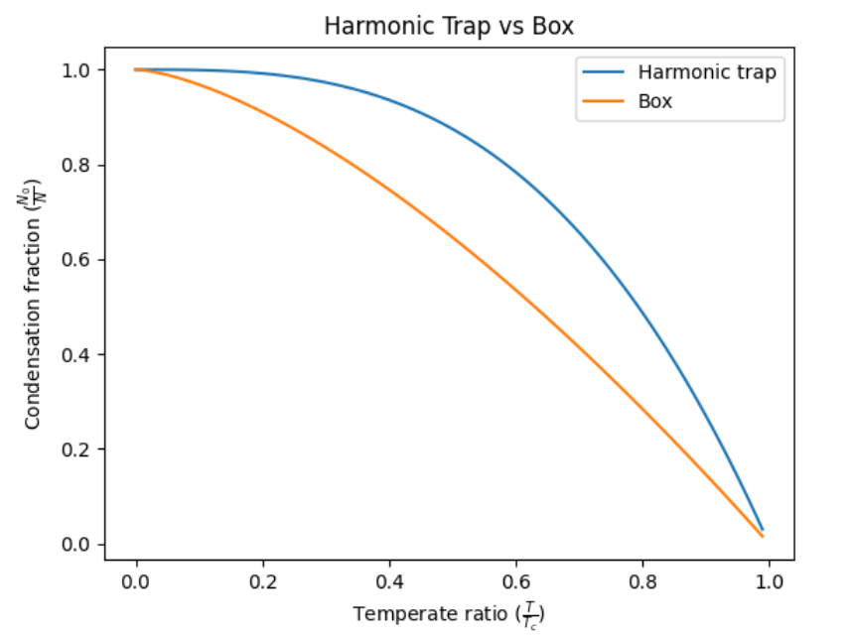
Ideal Bose trapped by an 3D harmonic potential
Doing the same steps but for a box as a trap we find the following equation:

Slide 17
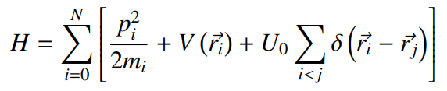
Gross-Pitaevskii Equation (GPE)
Used when dealing with real gases.
This theory describes the properties of an interacting boson gas at absolute zero temperature, with the scattering length much smaller than the average distance between gas particles, ensuring that the loss of atoms from the Bose-Einstein condensate (BEC) to other quantum states of the system is negligible.
Assume a system of N bosonic particles described by the following Hamiltonian:

Slide 18

Gross-Pitaevskii Equation (GPE)
The energy functional for N particles system is:
Merging both equation and using the Hartee approximation, we find that
Developing this expression leads to the following solution:

Slide 19

Gross-Pitaevskii Equation (GPE)
By defining the wave function of the condensate as a whole:
Since n(∼ r) is the spatial numerical density, by using a large N where N − 1 ≈ N, and assuming that L = E - μN. The minimum energy in relation of ψ ∗ can be establish using Lagrange method.

Slide 20

Gross-Pitaevskii Equation (GPE)
Organizing the terms we find the Gross-Pitaevskii Equation.
This theory is an approximation and therefore not universally valid. Once the loss of atoms to other quantum states of the system becomes significant, this approximation is no longer valid. Throughout the derivation, we assume that the only interaction present among particles is the contact interaction, which means that this approximation holds true for dilute gases (where na^3 ≪ 1) at absolute zero temperature (T = 0K).

Slide 21
Visualization of BCE - Observation of a BECs
The article Anderson, M. H., Ensher, J. R., Matthews, M. R., Wieman, C. E., & Cornell, E. A. (1995). Observation of Bose-Einstein condensation in a dilute atomic vapor. science, 269(5221), for the first time an BEC was observed.
In the experiment, a cloud of rubidium-87 atoms was cooled using laser cooling techniques and a combination of lasers and magnetic fields. This cooling process brought the atoms to extremely low temperatures. Once sufficiently cooled, the atoms were transferred into a magnetic trap created by electromagnetic fields to prevent them from escaping. To achieve Bose-Einstein condensation, an evaporative cooling, selectively removing the highest-energy atoms from the trap, which gradually formed a condensate as the remaining atoms with lower energies coalesced. The presence of the condensate was confirmed through laser imaging techniques that allowed visualization of its density distribution by shining a laser beam through the atom cloud. By setting T = 170nK and N/V = 2.5 × 10^12cm^3 three BCEs were observable.

Slide 22
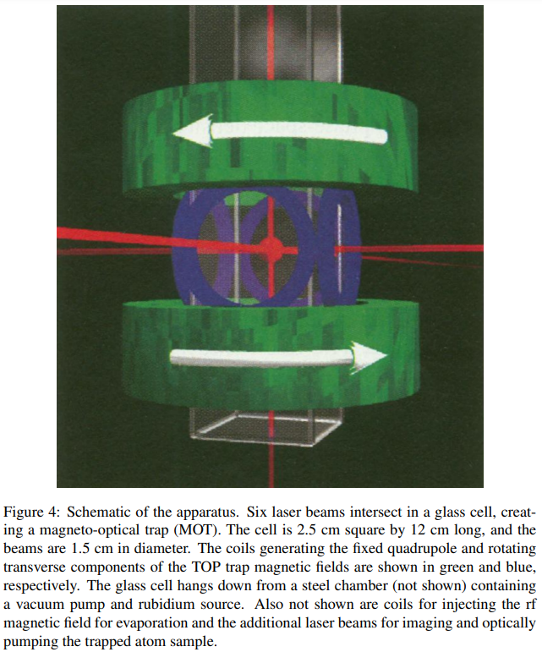
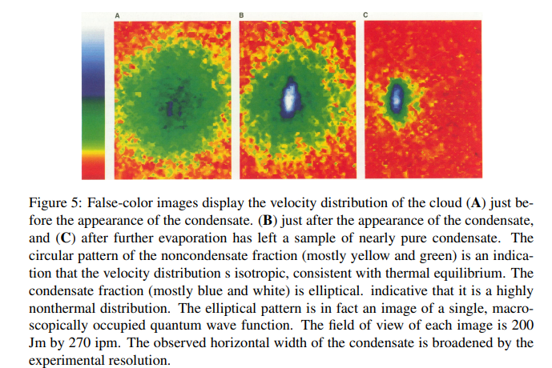
Visualization of BCE - Observation of a BECs

Slide 23
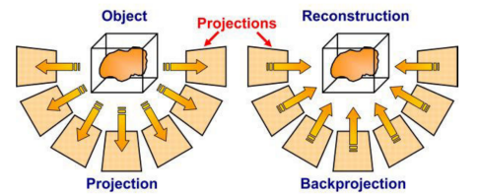
Visualization of BCE - 3D reconstruction
The work presented in Smaira, Andre de Freitas. Quantum fluids spatial distribution evaluation and its characterization, an 3D reconstruction was made for BCE, allowing it’s visualization computationally.
The reconstruction was made via tomography.

Slide 24
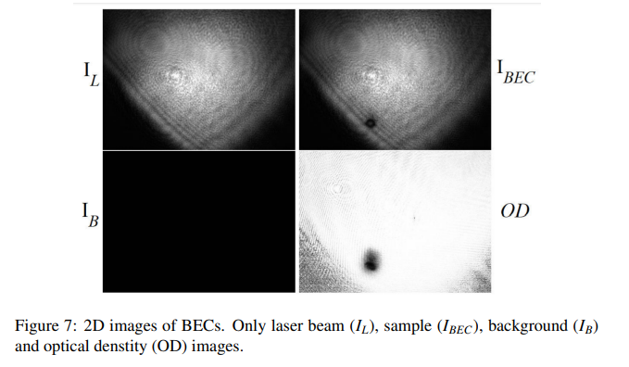
Visualization of BCE - 3D reconstruction

Slide 25
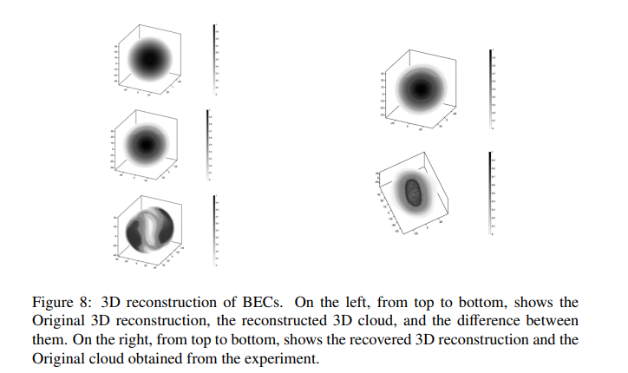
Visualization of BCE - 3D reconstruction

Slide 26
Conclusion
The differences between Fermions and Bosons were presented, as well as what is a BEC.
The example of an ideal bose gas trapped by 3D harmonic potential was made, in it we established some parameters like the Fraction condesented and the Critical Temperature, as well as compared the results with the box trap, in it we saw that the particles tend to the ground state faster in the harmonic trap then the box trap.
The deduction of the Gross-Privatskii was made, as well as an simple explanation to when the equation should be used.
Two different experiments were presented to visualize the BEC.

Slide 27
References
Anderson, M. H., Ensher, J. R., Matthews, M. R., Wieman, C. E., & Cornell, E. A. (1995). Observation of Bose-Einstein condensation in a dilute atomic vapor. science, 269(5221), 198-201.
Smaira, André de Freitas. Dinâmica de um condensado de Bose-Eintein contendo sólitons [dissertação]. São Carlos: Universidade de São Paulo, Instituto de Física de São Carlos; 2015 [citado 2023-06-19]. doi:10.11606/D.76.2015.tde-02042015-170017.
Bradley, C. C., Sackett, C. A., Tollett, J. J., & Hulet, R. G. (1995). Evidence of Bose-Einstein condensation in an atomic gas with attractive interactions. Physical review letters, 75(9), 1687.
Smaira, André de Freitas. Quantum fluids spatial distribution evaluation and its characterization [tese]. São Carlos: , Instituto de Física de São Carlos; 2019 [citado 2023-06-19]. doi:10.11606/T.76.2019.tde-18052020-145912.

Slide 28
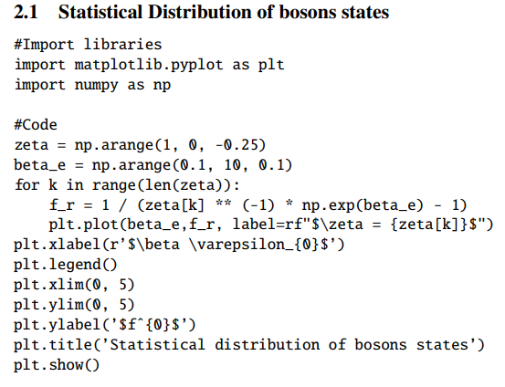
Codes

Slide 29
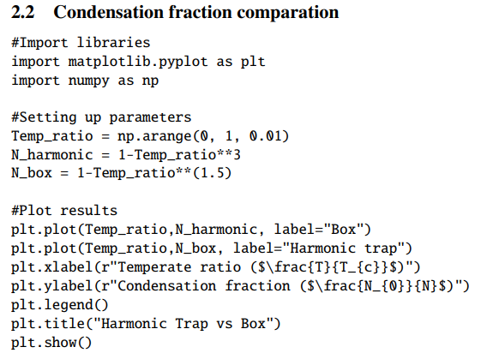
Codes

Slide 30


Thank you for your attention

